Slide 1
8086 Signals

Slide 2
8086 - 16 bit CPU
Clock rates - 5, 8, 10 MHz
40 pins / signals
Operates in 2 modes - 1) single processor mode (minimum mode) 2) multiprocessor mode (maximum mode)
Signals - 1) Signals having common functions in minimum as well as maximum mode
2) Signals having special functions for minimum mode
3) Signals having special functions for maximum mode

Slide 3
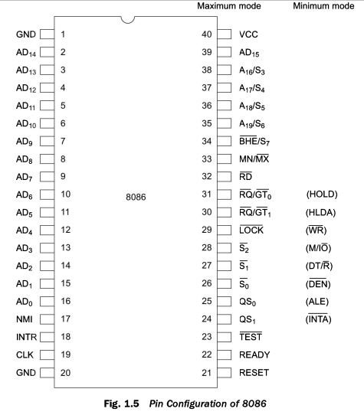

Slide 4
Signals common to both minimum and maximum mode
AD15-AD0
A19/S6, A18/S5, A17/S4, A16/S3
BHE/ S7 - Bus High Enable / Status
RD/ Read
READY
INTR - Interrupt Request
TEST
NMI - Non Maskable Interrupt
RESET
CLK - Clock Input
Vcc
GND
MN/ MX

Slide 5
Signals for minimum mode
M/ I/O
INTA - Interrupt Acknowledge
ALE - Address Latch Enable
DT/R - Data Transmit / Receive
DEN - Data Enable
HOLD, HLDA - Hold/ Hold Acknowledge

Slide 6
Signals for Maximum mode
S2, S1, S0 - Status lines
LOCK -
QS1, QS0 -
RQ/ GT0, RQ/ GT1 - Request / Grant

Slide 7
Signals common to both minimum and maximum mode
AD15-AD0 - time multiplexed memory IO address and data lines
T1, T2, T3, T4, TW - are the clock states of a machine cycle
During T1 state - address remains on the bus
During T2, T3, T4 and TW - data is available on the data bus
Active high pins

Slide 8
A19/S6, A18/S5, A17/S4, A16/S3 - time multiplexed address and status lines
During T1, for memory operations these are the most significant address lines
During T1, IO operations these signals are low
During T2, T3, T4, TW - for memory or IO operations status information is available
The status of the IE flagbit is updated during the beginning of each machine cycle
S4, S3 - indicates the current segment register being used for memory access
S6 is always low
The address bits are separated from the status bits using latches controlled by the ALE signal.

Slide 9
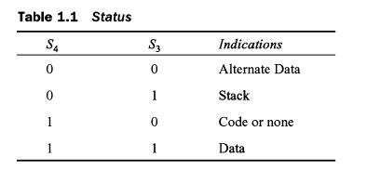

Slide 10
BHE/ S7 - Bus High Enable / Status
BHE indicates the transfer of data over the higher order (D15-D8) data bus
it goes low for data transfer through D15-D8
Used to derive the chip select of odd address memory bank and peripherals
It is low during T1 for read, write, interrupt acknowledge cycles, whenever a byte is to be transferred on the higher byte of the data bus
Status information is available during T2, T3, T4 and TW.
It is active low.
S7 is currently not used.

Slide 11
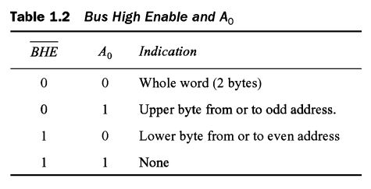

Slide 12
RD - Read
It is active low.
During low, it indicates the peripherals that the processor is performing a memory or IO read operation.
READY -
acknowledgement from the slow devices or memory that they have completed the data transfer
It is active high

Slide 13
INTR - Interrupt Request
It is a level triggered input signal
During the last clock cycle of each instruction it is sampled to determine the availability of request
If any interrupt request is pending the processor enters the interrupt acknowledge cycle
This signal can be masked by resetting the interrupt enable flag.
This signal is active high.

Slide 14
TEST -
WAIT instruction examines this signal.
If TEST = low, then execution will continue
Else the processor remains in the idle state

Slide 15
NMI - Non Maskable Interrupt
It causes a TYPE 2 interrupt
NMI is not maskable internally by software
A transition from low to high initiates the interrupt response at the end of the current instruction

Slide 16
RESET -
It causes the processor to terminate the current activity and start execution from FFFF0 H
It is active high.
It must be active for atleast four clock cycles.
It restarts execution when the RESET returns low.
CLK - clock input provides the basic timing for processor operation and bus control activity
Range of frequency for different versions is from 5 MHZ to 10 MHZ.
Vcc, Gnd

Slide 17
MN/ MX -
The logic level at this pin decides whether the processor is to operate in either minimum (single processor) or maximum mode (multiprocessor).

Slide 18
Signals for minimum mode operation of 8086
M/ IO - Memory / IO - ( equivalent to S2 in maximum mode)
During low, it indicates the CPU is having an IO operation
During high, it indicates that the CPU is having a memory operation
INTA - Interrupt acknowledge
low, indicates that CPU has accepted the interrupt
It is active low.

Slide 19
ALE - Address Latch Enable
This output signal indicates the availability of the valid address on the address/ data lines.
It is connected to the latch enable input of latches.
It is active high.

Slide 20
DT/ R - Data Transmit / Receive (equivalent to S1 in maximum mode)
This output decides the direction of the data flow through the transrecievers.
When the processor sends out data this signal is high and when the processor is receiving data, this signal is low.
DEN - Data Enable
Indicates the availability of data over the address and data lines.
It is used to enable the transreceivers to separate the data from the multiplexed address and data signal

Slide 21
HOLD, HLDA - hold/ hold acknowledge
High indicates to the processor that another master is requesting the bus access.
CPU after receiving HOLD request, it issues hold acknowledge on HLDA
If HOLD is low, then CPU lowers HLDA

Slide 22
Maximum mode operation of 8086
S2, S1, S0 - Status lines
It indicates the type of operation carried out by processor.
Table 1.3

Slide 23
LOCK -
If low, it indicates that other system bus masters will be prevented from gaining the system bus
This signal is activated by LOCK prefix instruction
It remains active until the completion of the next instruction
While a critical instruction execution is going on, LOCK instruction prevents the other processors connected not to gain access to bus.

Slide 24
QS1, QS0 - Queue Status
Gives information about the status of the code-prefetch queue.
Table 1.4
Pipelined processing of instructions - faster execution of instructions
6 - byte instruction prefetch queue
Even the largest instruction(6 bytes) can be prefetched from the memory and stored in the prefetch queue.
Explain Instruction Pipelining

Slide 25
RQ/ GT0, RQ/GT1 - Request / Grant
Used by other local bus masters in maximum mode
It forces the processor to release the local bus at the end of the processors
Bidirectional pins
RQ/GT0 has higher priority than RG/GT1

